Slide 1


SIMPLE CLASSIFICATION OF
IRIS PLANTS USING DECISION TREE CLASSIFIER
DIMAS TRIPANGESTU

Slide 2
INTRODUCTION AND OBJECTIVE
The data set contains 3 classes of 50
instances each, where each class refers to a type of iris plant. One class is linearly
separable from the other 2; the latter are NOT linearly separable from each other.

Slide 3




TOOLS USED:

Slide 4
CONTENT
01.
Input Data
03.
Data Modelling
02.
EXPLORATORY DATA ANALYSIS (EDA)
04.
Data Visualization

Slide 5
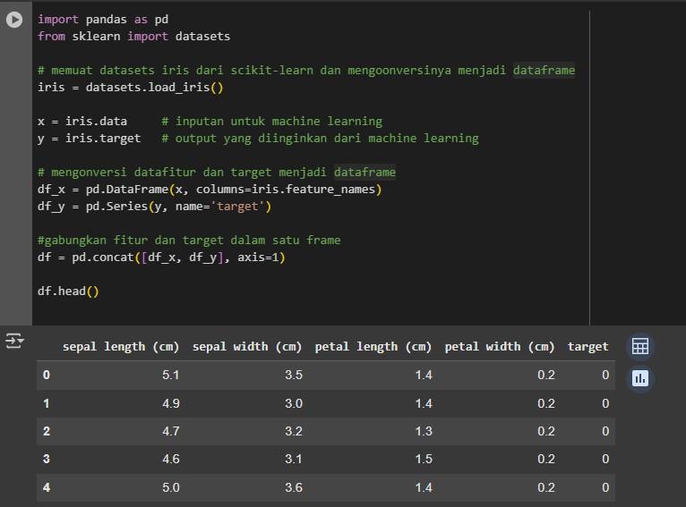
INPUT DATA

Slide 6
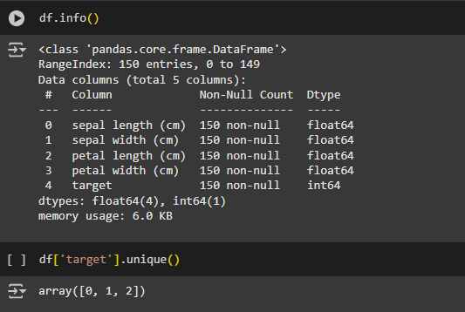
EXPLORATORY DATA ANALYSIS (EDA)

Slide 7
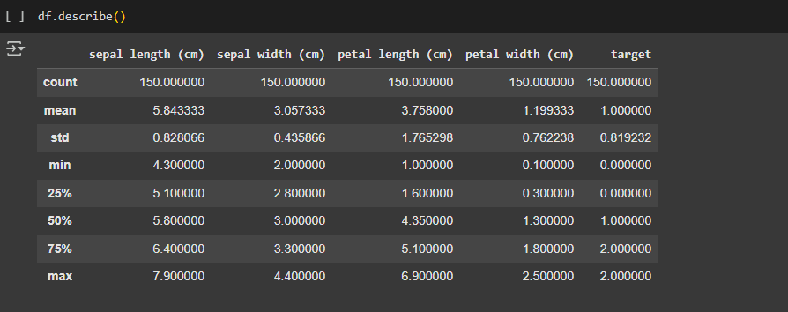
EXPLORATORY DATA ANALYSIS (EDA)

Slide 8
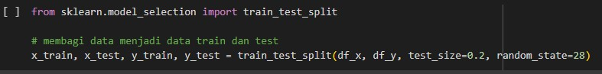
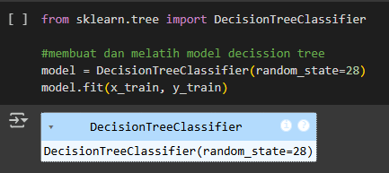
DATA MODELLING

Slide 9
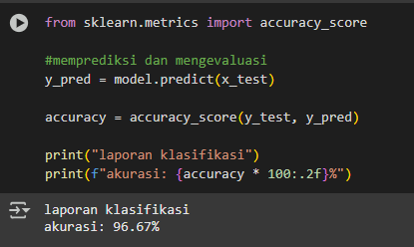
DATA MODELLING

Slide 10
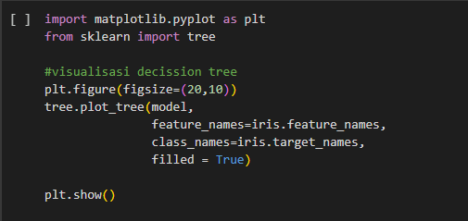
DATA VISUALIZATION

Slide 11
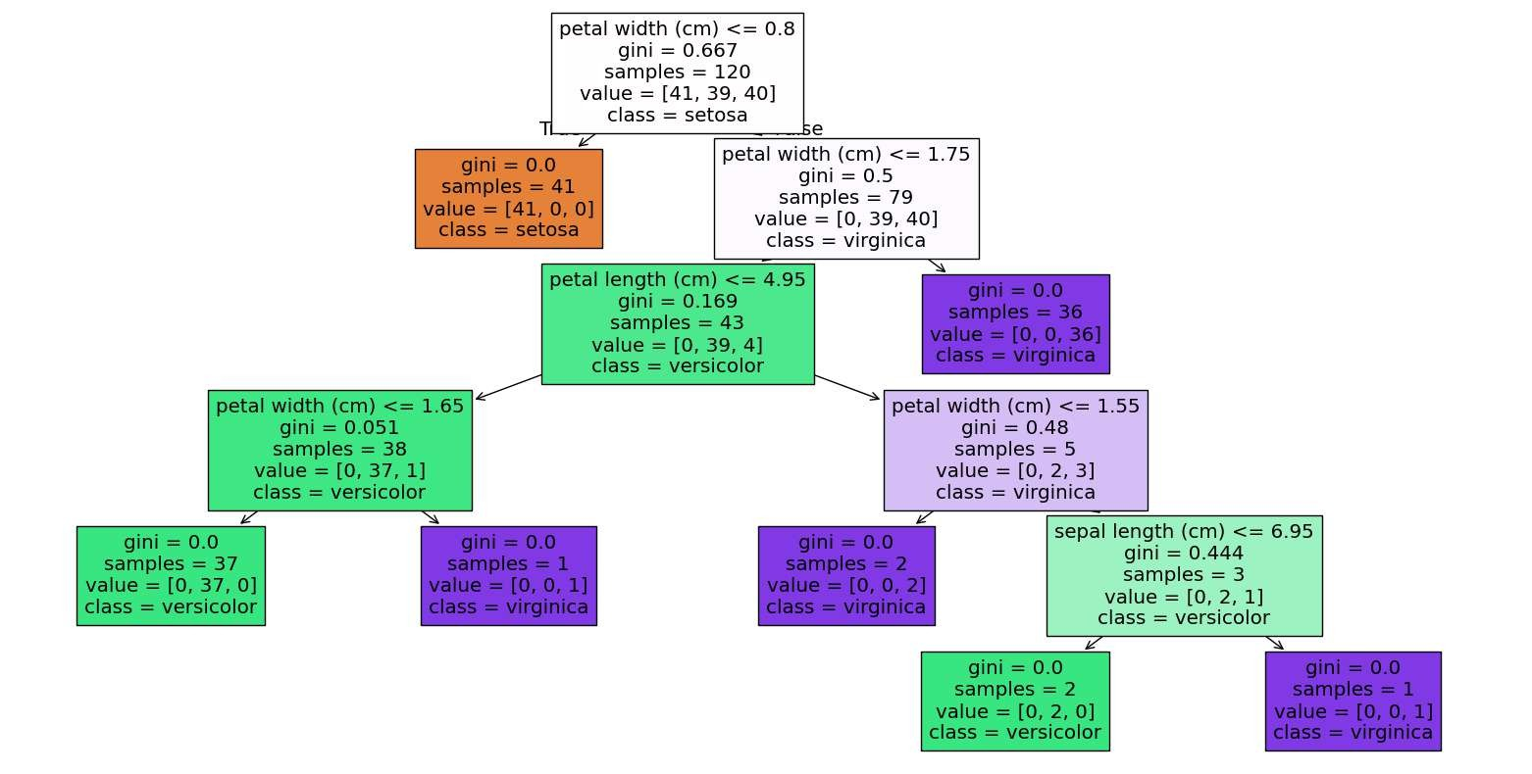
DATA VISUALIZATION

Slide 12




THANK YOU VERY MUCH!
IF YOU HAVE ANY QUESTIONS, SUGGESTIONS OR FEEDBACKS, PLEASE DO NOT HESITATE TO REACH ME THROUGH THE CONTACTS BELOW:
dimastripangestu2803@gmail.com
https://github.com/DimasTripangestu
www.linkedin.com/in/dimas-tripangestu-6b75b4331

